Slide 1

Decoding the representation of space in the auditory cortex
Marija Nedeljković Slice of Science Workshop
17. August 2022

Slide 2

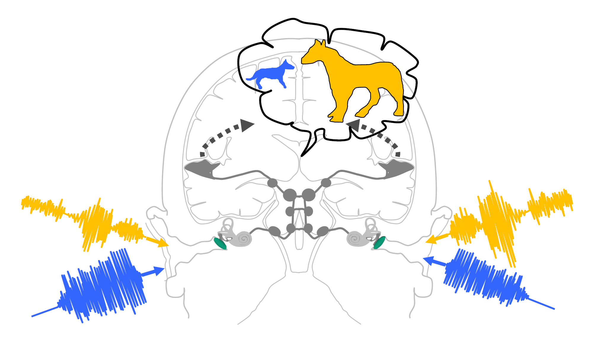
The brain constructs our entire (360 °) auditory world with information from just two „microphones“ (our ears).
B. Grothe
We know a lot about the physical cues we use to encode space, but little about how the brain represents this encoding.
1

Slide 3

Psychophysical (human) experiments indicate that neuronal tuning toward the front is of particular importance…
iStock™ via www.thetradenews.com
… but research in animal models have been thus far insufficient to support or contradict this claim…
2

Slide 4

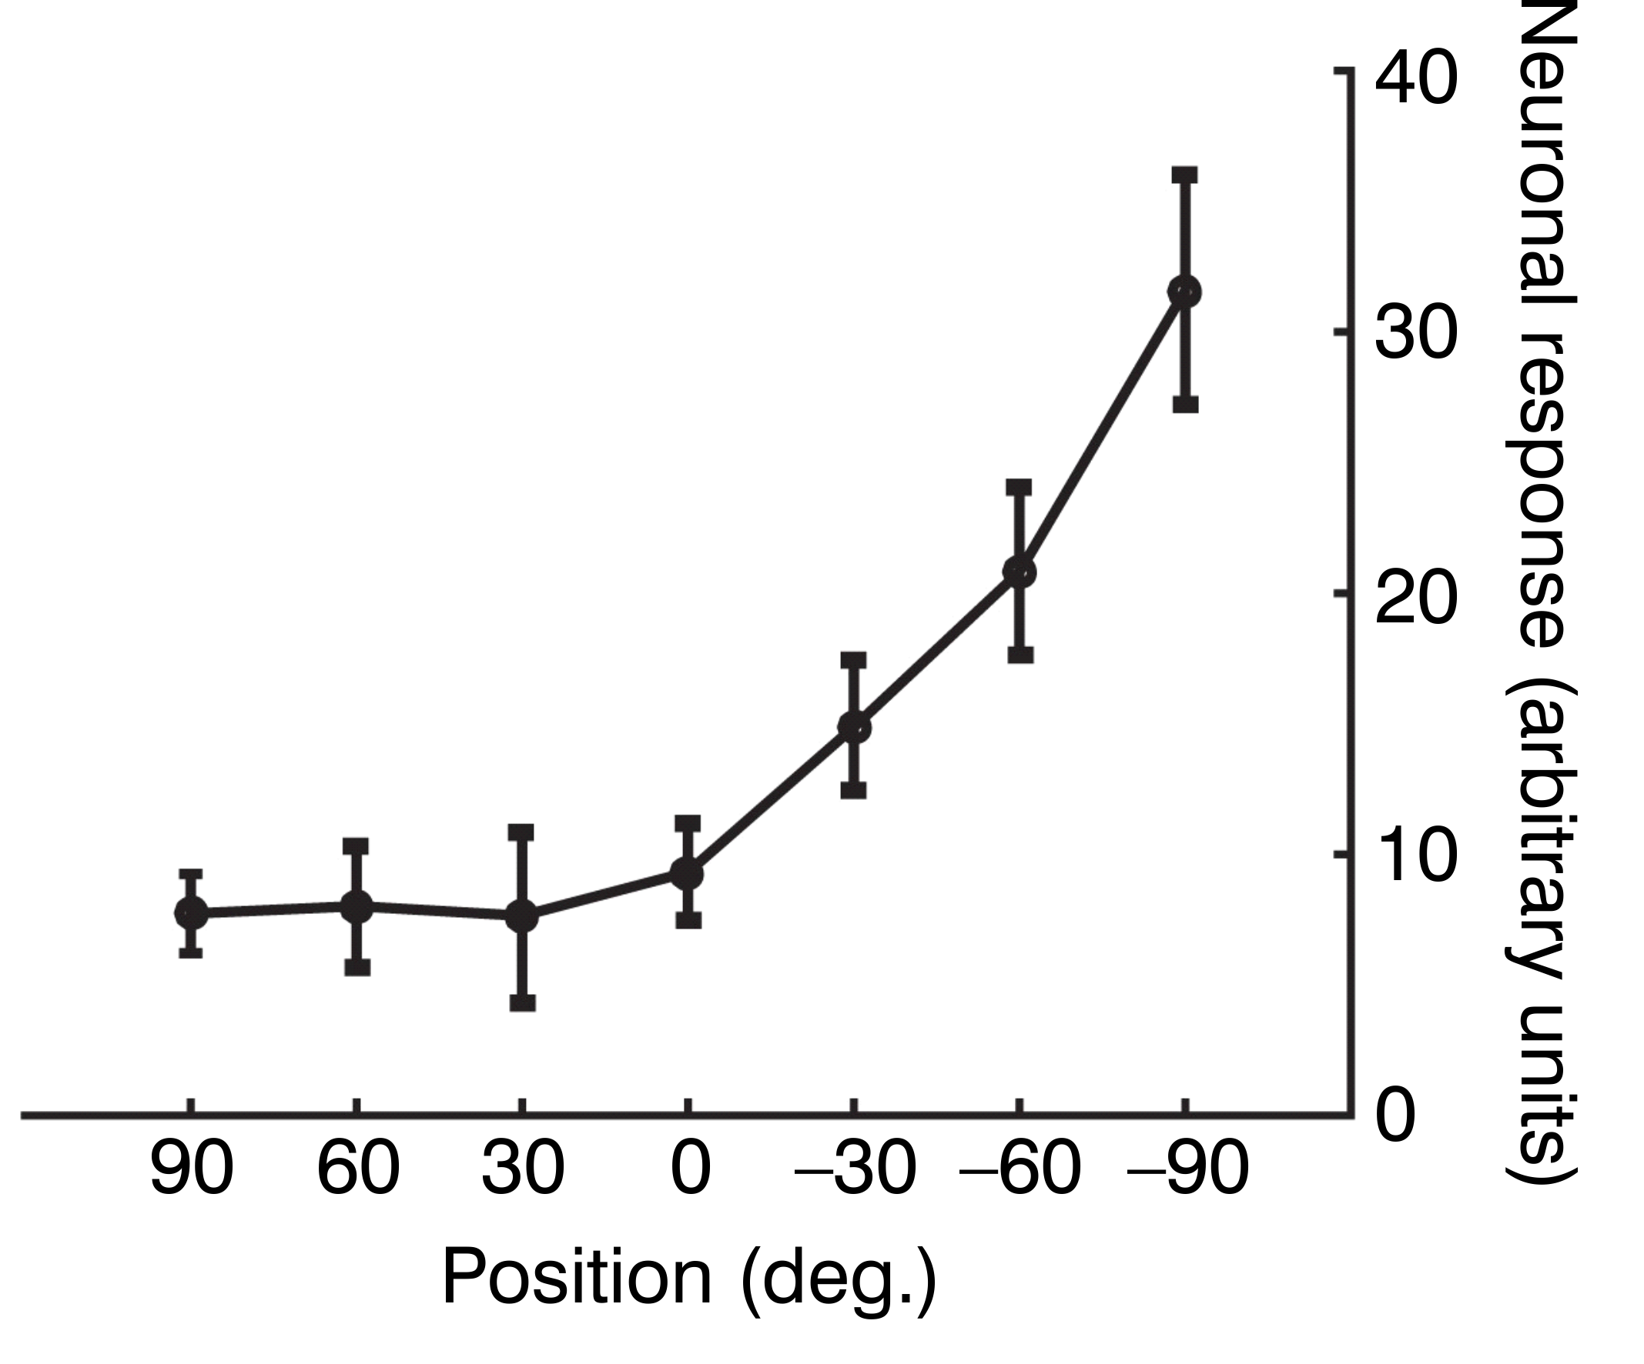
A major hurdle has been that most animal studies have been performed in anaesthetised preparations.
z
z
Contra.
side
z
Ipsi. side
Front
Matthias Gumbert
Adapted from Panniello et al. (2018)
In anaesthetised animals, there is no evidence for prominent tuning toward the front!
3

Slide 5

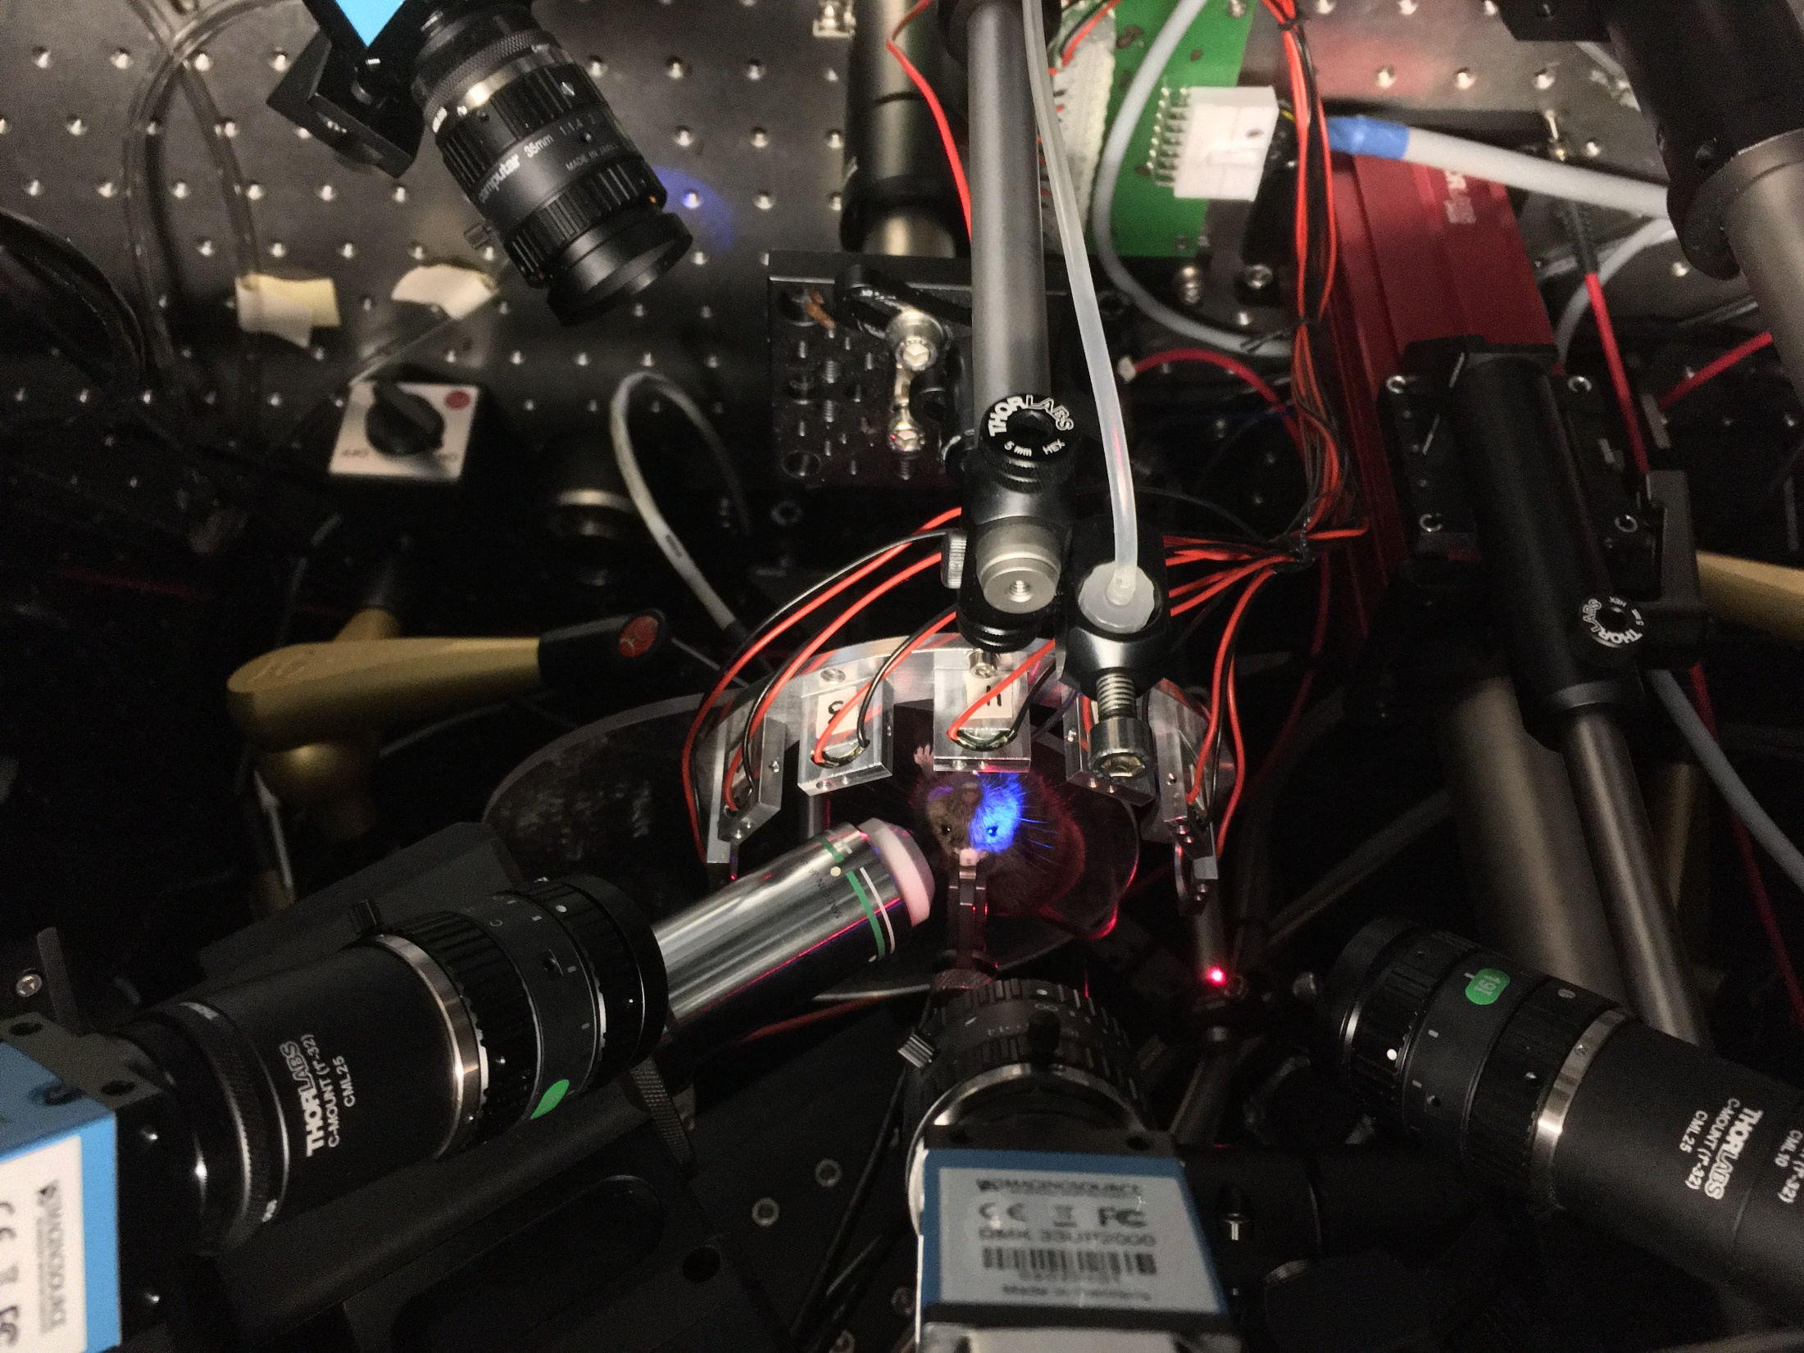
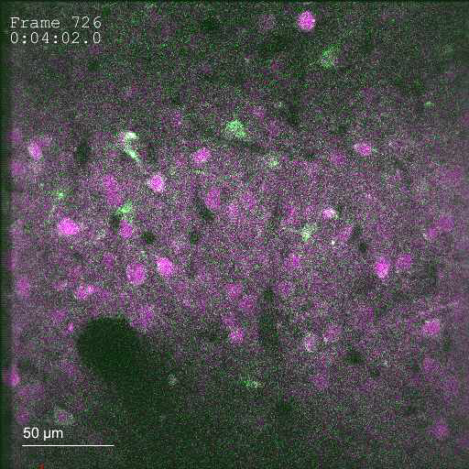
So, we compared spatial tuning in the auditory cortex of mice between anaesthetised and awake states using chronic Ca-imaging.
Matthias Gumbert
The setup
Calcium levels are a proxy of neuronal activity.
Green: calcium indicator (GCamp6s)
Magenta: structural marker (mRuby2)
4

Slide 6
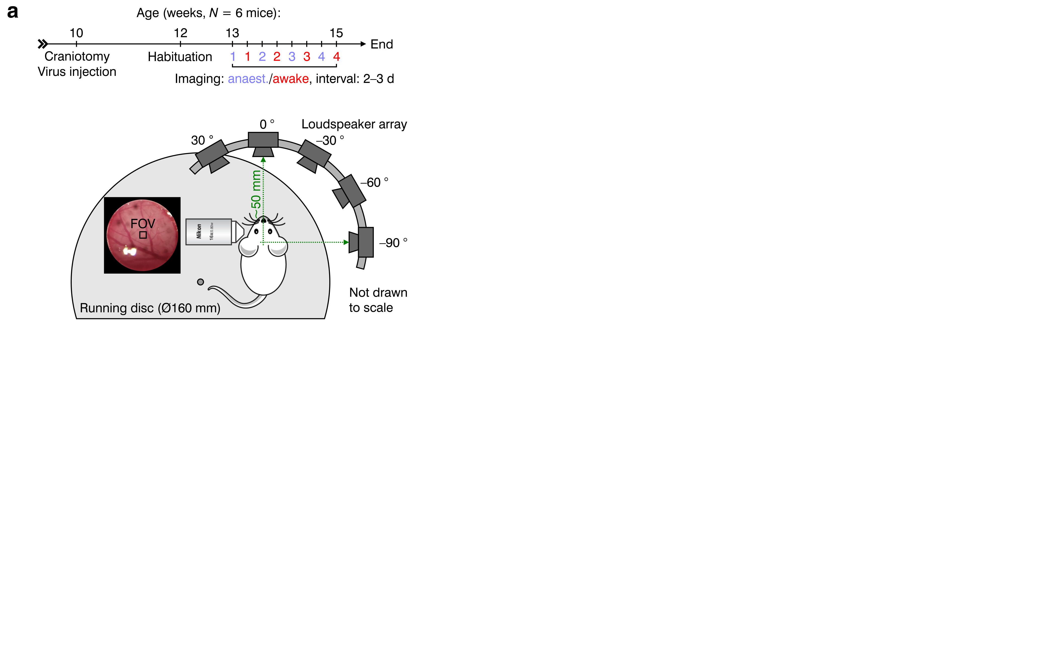
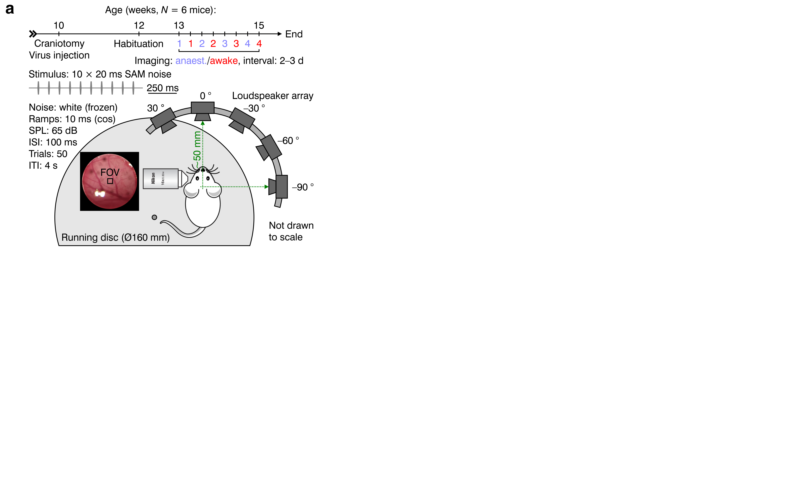
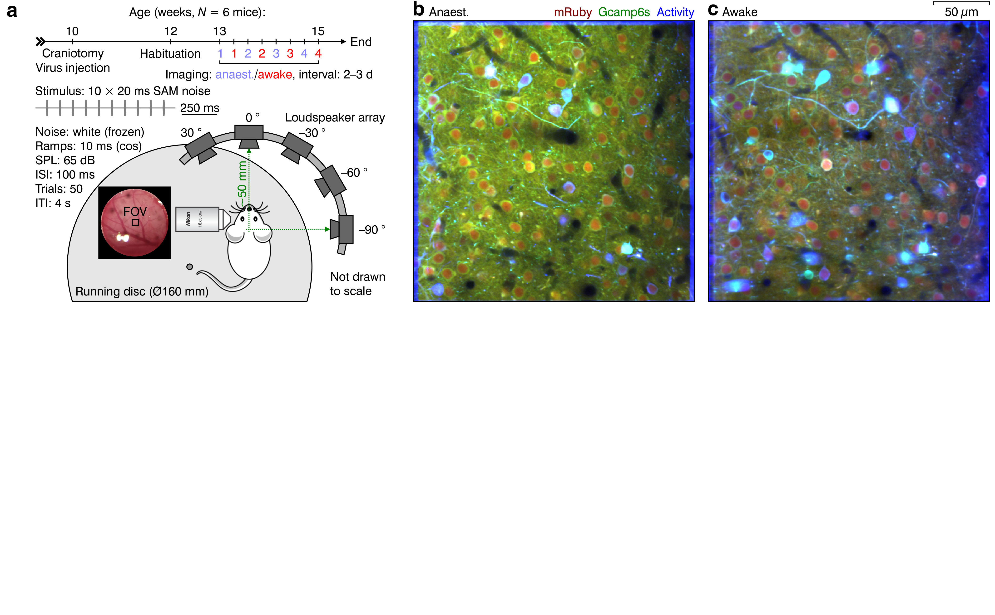
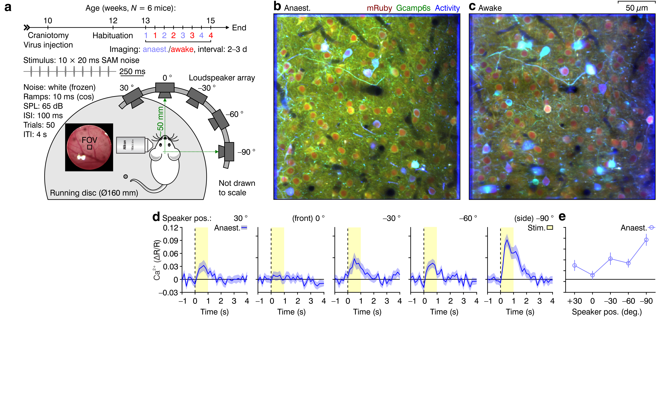
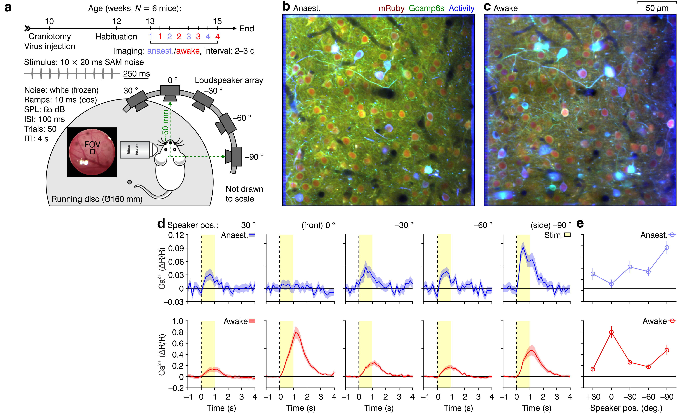
We found prominent tuning toward the front in awake animals!
Anaesthetised
Contra. tuned
Front tuned
Awake
5

Slide 7
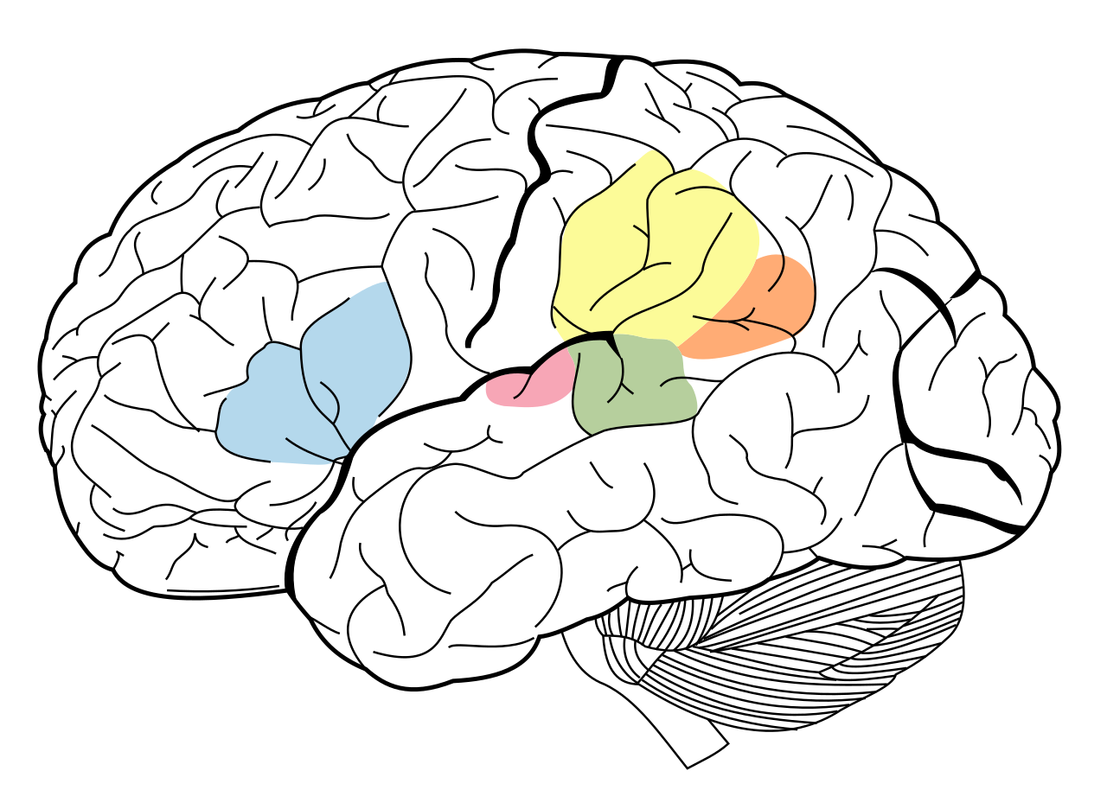

But we still have a problem: how to understand how the population of neurons encodes space under different states?
Auditory cortex
×
Wikipedia.org
There is no „map“ of auditory space in the cortex, so positions cannot be simply „read-out“ based on location in the brain!
6

Slide 8
…
Wikipedia.org
…
6

